Slide 1
Electronically Designed Controllers using Op-Amps
Tyler McKean
mckean.t@northeastern.edu
EECE5580 – Spring 2022
April 29, 2022

Slide 2
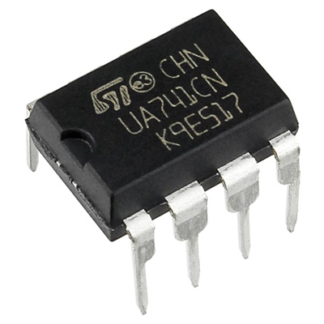
Project Outline
Building Blocks of Electronically Design Controllers
Characteristics of Op-Amp Circuits
Different Feedback Amplifiers
DC Motor Speed Control using Op-Amp PID Controller
Conclusion
741 Op-Amp IC

Slide 3
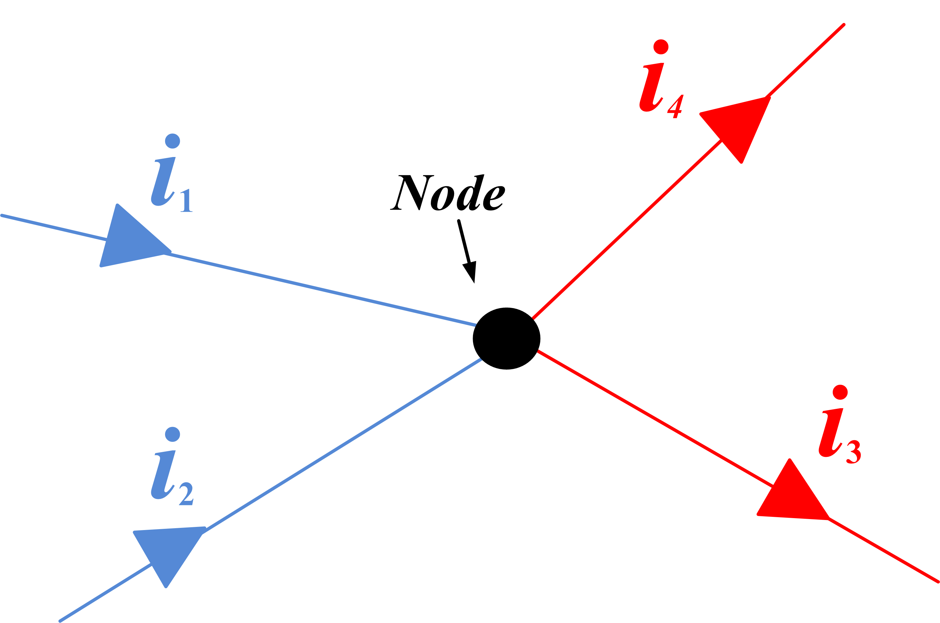
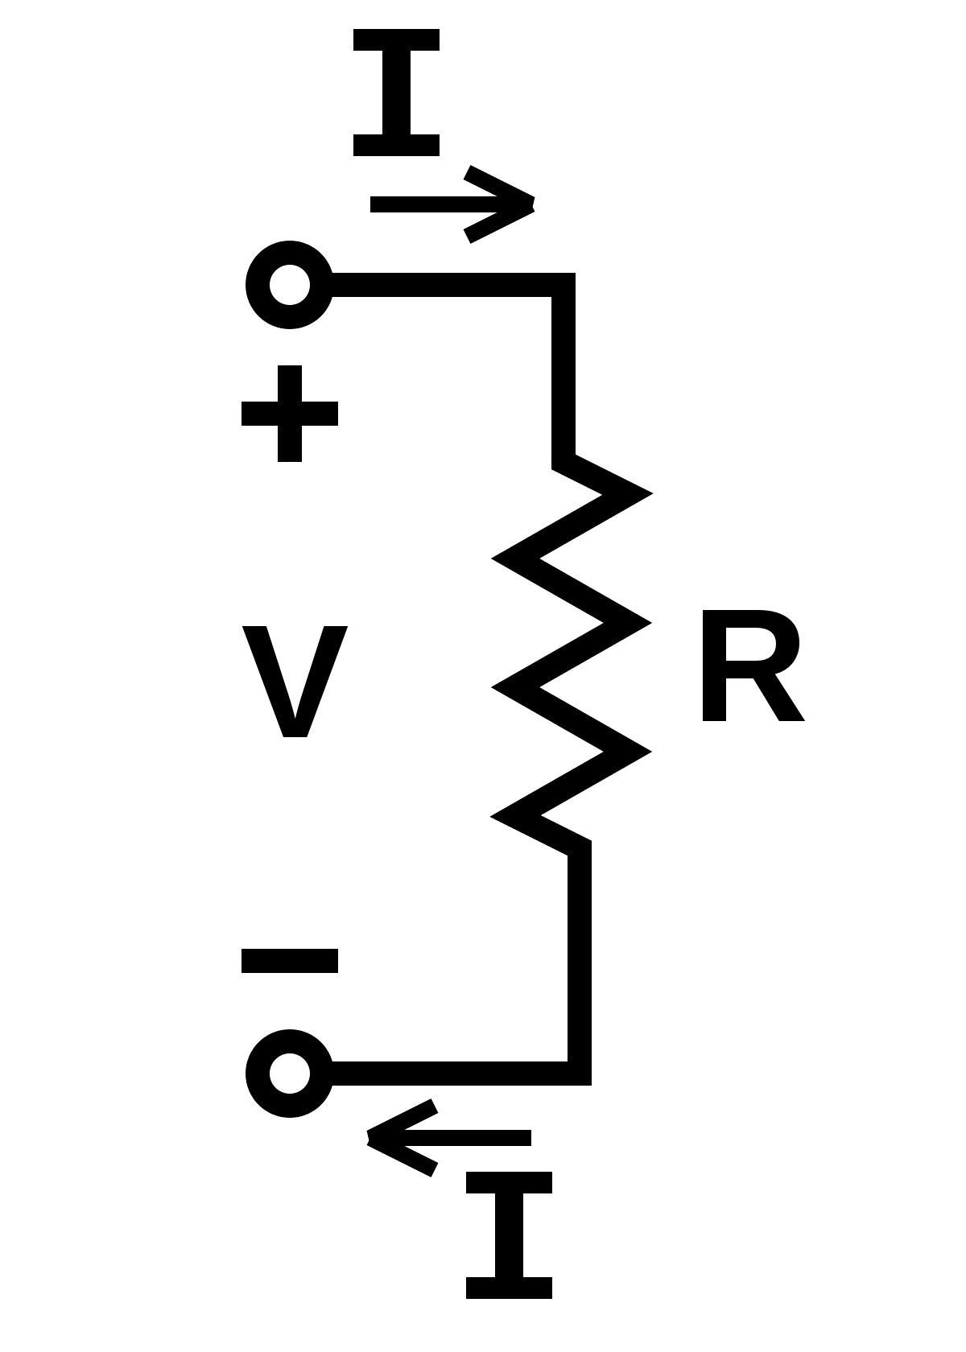
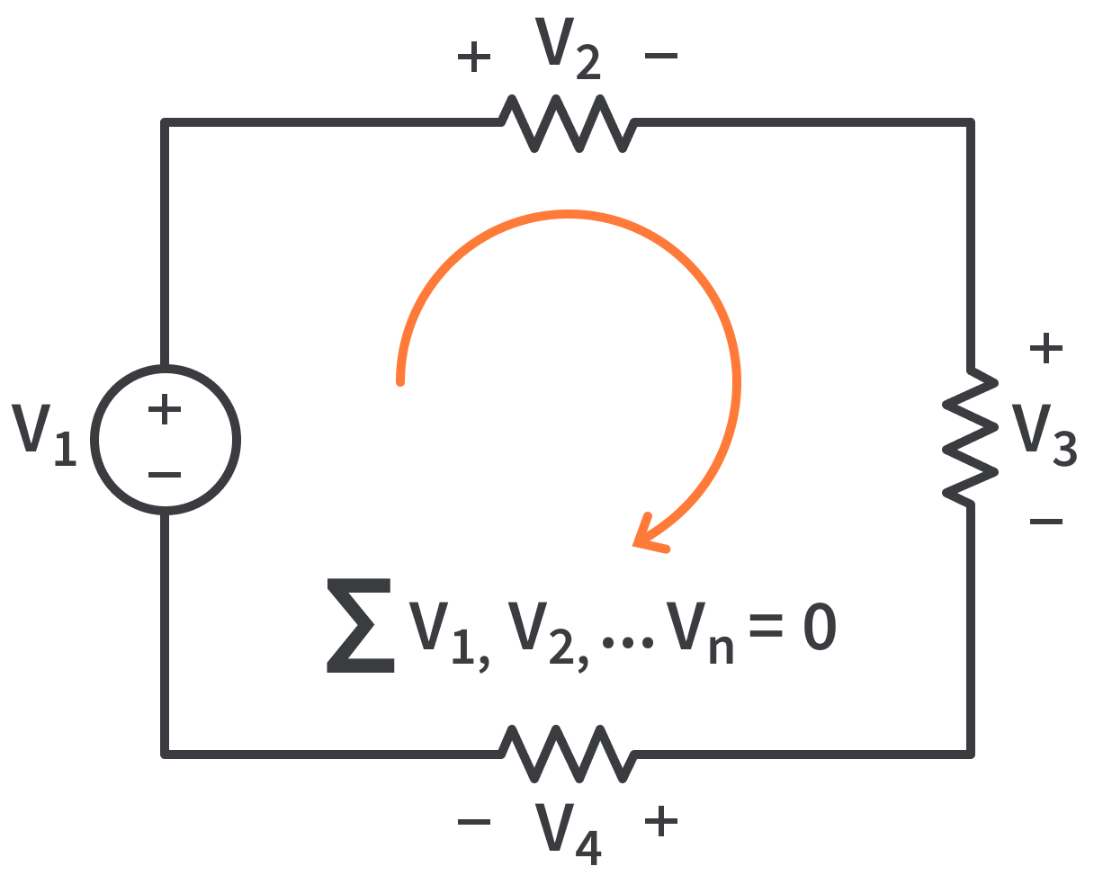
Building Blocks of Electronic Controllers
Circuits are designed using the following concepts:
Current: I – the rate of change of electrical charge
Voltage: V – potential energy between two nodes
Resistance: R – resistance to the flow of current
Capacitance: C – the ratio of the charge on one plate of the capacitor to the voltage difference between two plates
Impedance: Z – the complex ratio of phasor V to phasor I where R = Re Z and X = Im Z and Z = R ± jX
We use analysis methods such as Ohm’s Law, Kirchoff's Voltage and Current Laws to derive the equations for the voltage drop across various components, the current entering or leaving a node in the circuit, and the differential equations that govern these electrical circuits
Kirchoff’s Current Law
Ohm’s Law
Kirchoff’s Voltage Law

Slide 4
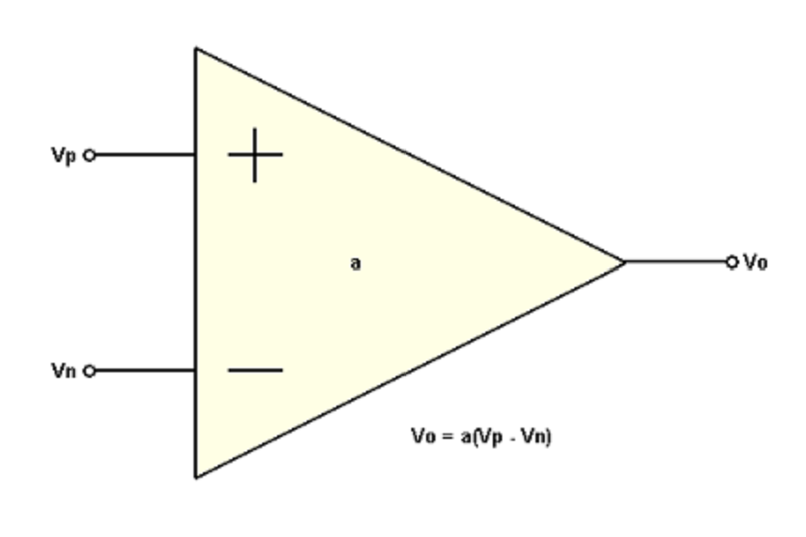
Operational Amplifier Description
Operational Amplifier: An active circuit element designed to perform mathematical operations depending on the arrangement of passive circuit elements
addition/subtraction,
multiplication/division,
differentiation, and integration.
Modern implementation of Harold Black's feedback amplifier and is a universal component that is widely used for instrumentation, control, and communication
Very versatile as any linear system can be implemented by combining operational amplifiers with resistors and capacitors, most notably, analog proportional-integral-derivative controllers
Noninverting Op Amp Schematic Symbol and Physical Op Amp IC

Slide 5
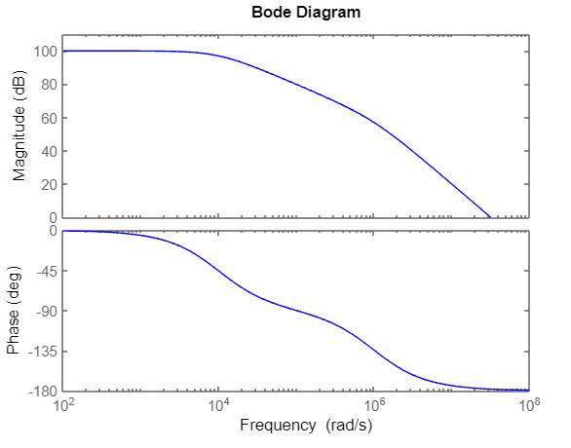
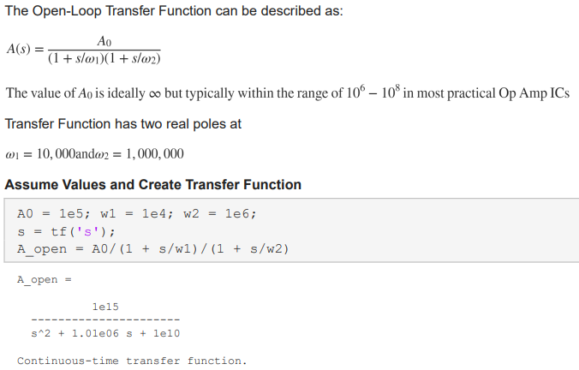
Operational Amplifier Characteristics
Ideal Operational Amplifiers
Infinite Open Loop Gain
Infinite Input Impedance
Zero Output Impedance
Open Loop Gain of Op-Amp provides 100 dB gain for low frequencies and -180 degrees phase shift

Slide 6
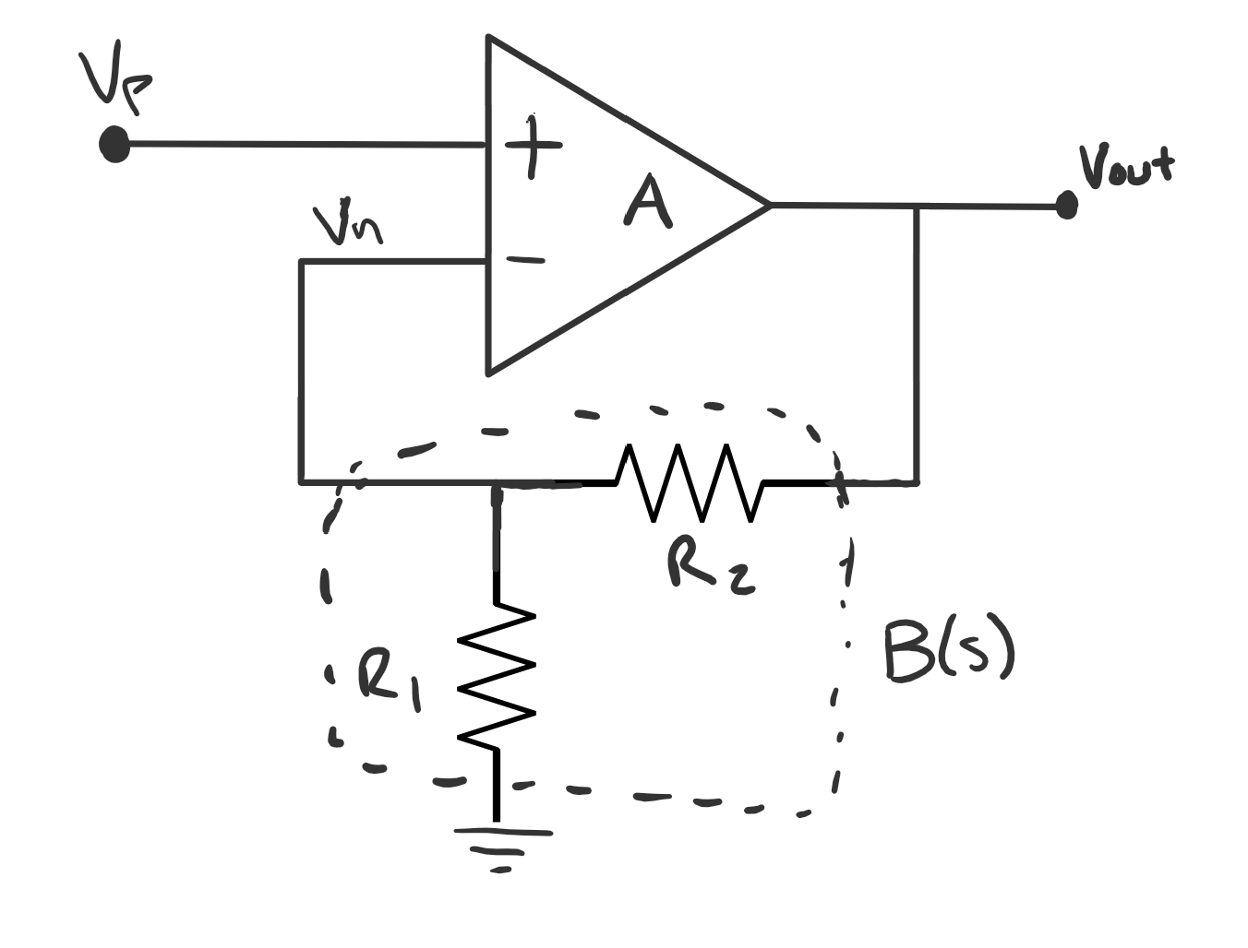
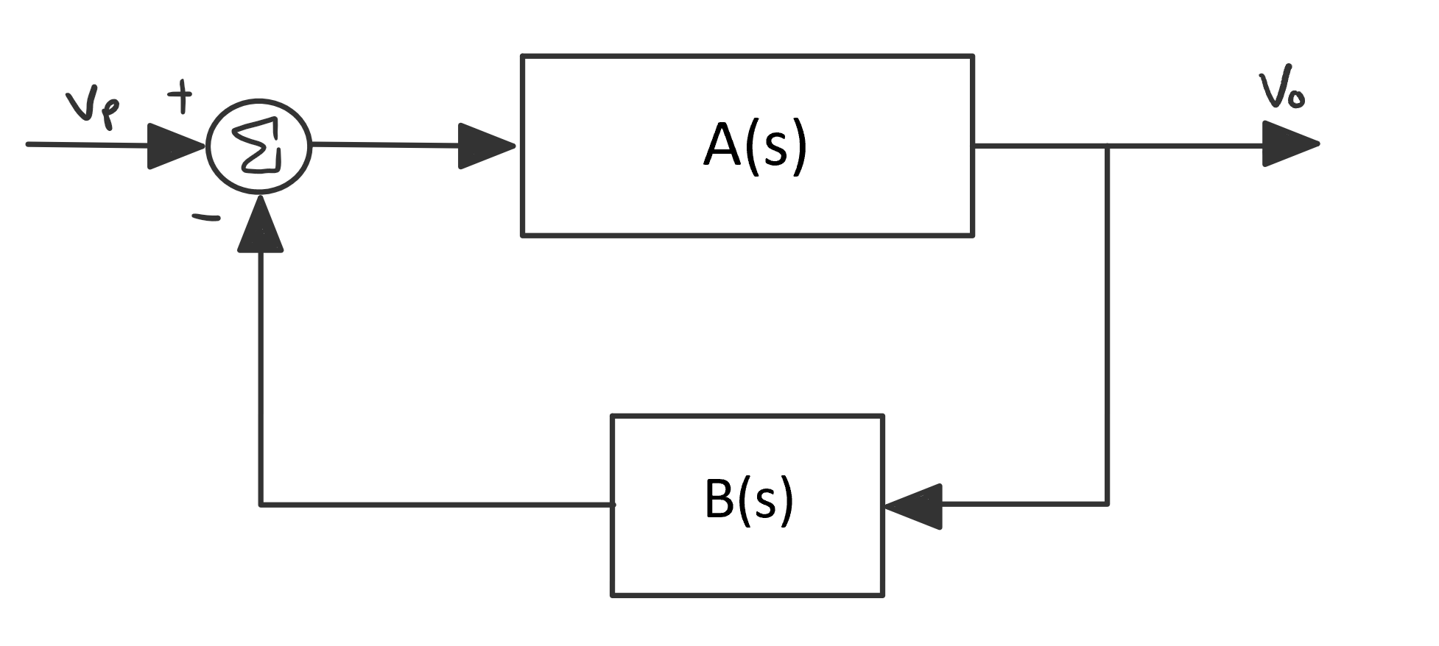
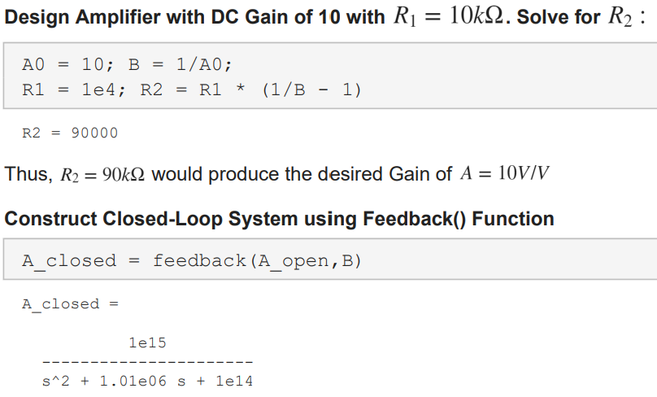
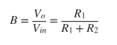
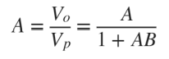
Closing the Loop for Op Amps
Placing two resistors attached between the output and one of the input terminals creates a feedback network, thus closing the loop
The Feedback network B(s):
voltage divider between input and output.
Noninverting Feedback Amplifier
Closed-Loop Block Diagram

Slide 7
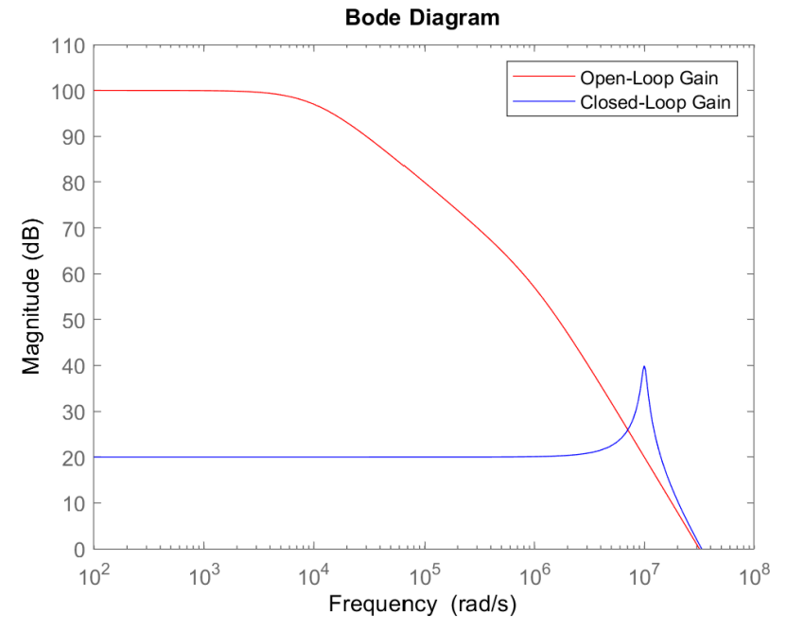
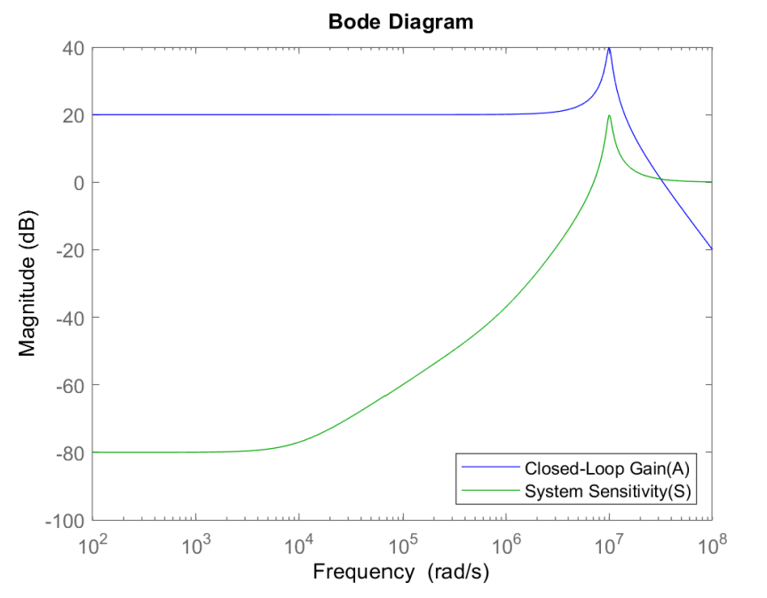
Op-Amp Trade-Offs
We can see that the Closed-Loop Gain is much lower for Low Frequencies, but bandwidth has increased as a trade-off
This Gain vs Bandwidth trade-off presents a powerful tool when designing feedback circuits as it gives a drastic reduction in gain sensitivity to variations that allows making precise systems from uncertain components
Feedback can be used to trade high gain and low robustness for low gain and high robustness

Slide 8
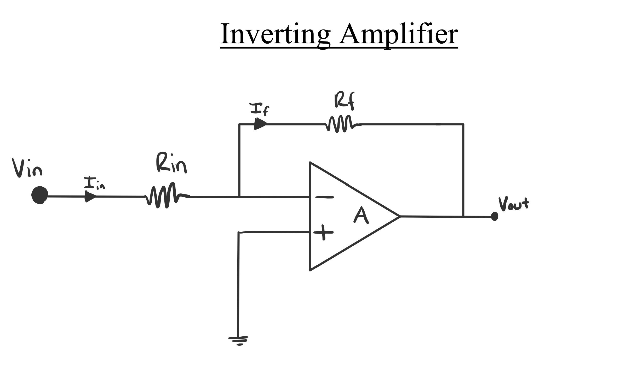
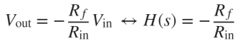
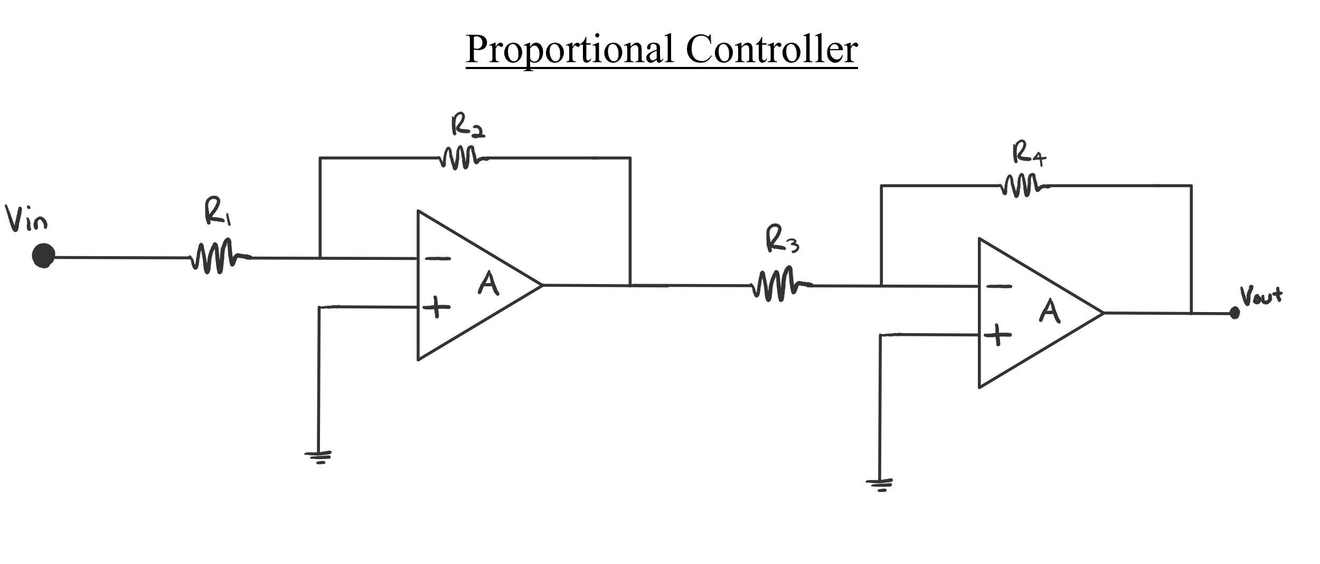
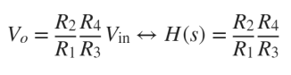
Feedback Amplifiers: Proportional Controller
Since the Op-Amp has ideally infinite input impedance, thus no current will flow through the + or - terminals and will result in zero voltage drop. After performing some KCL to solve for the transfer function of the system, we find:
Thus, this arrangement of components provides a negative amplitude gain to any signal that is passed through this circuit. If we cascade a second inverting amplifier with equivalent resistors, we get a Proportional Controller

Slide 9
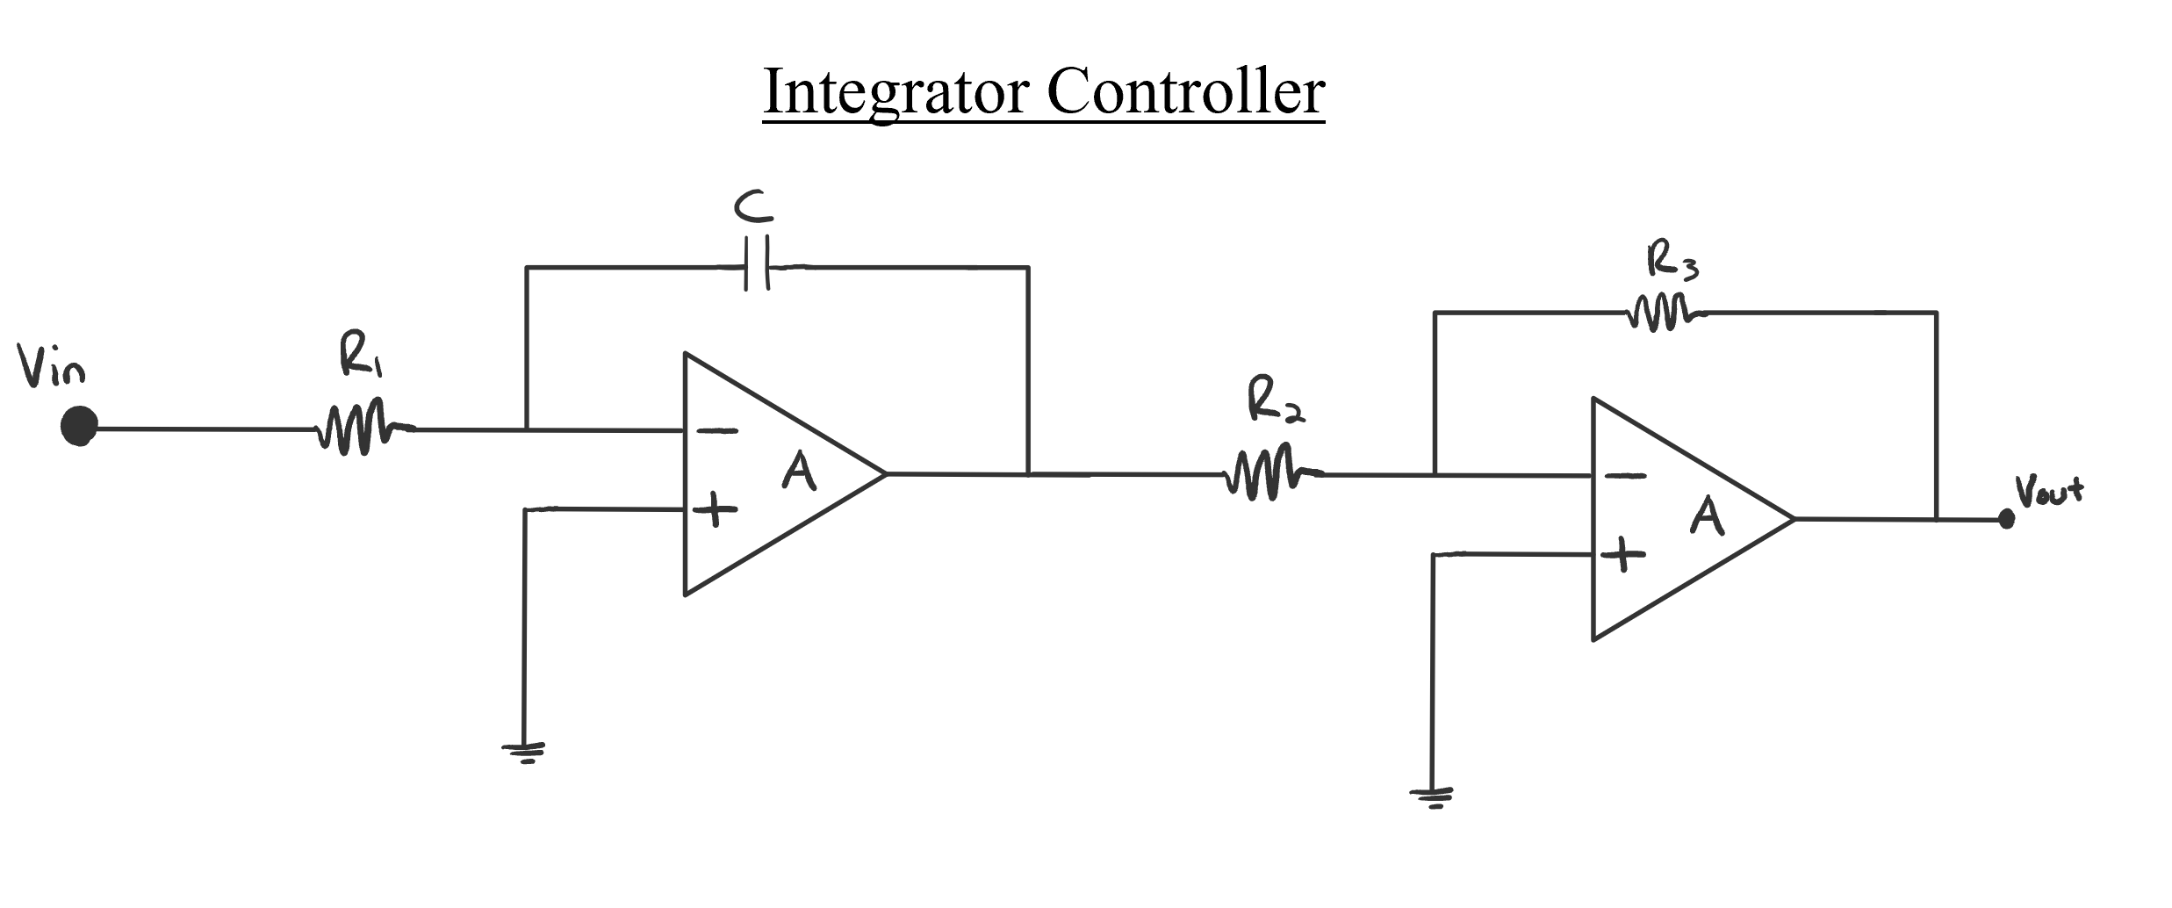
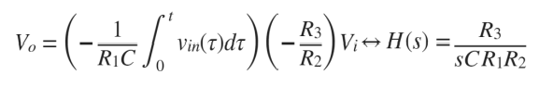
Feedback Amplifiers: Integrator Controller
Using two op-amps, two resistors, and two capacitors, we can form an integrator controller
Produces an output voltage that is proportional to the area contained under the input waveform
This controller utilizes two inverting amplifiers that serve to either prove an amplitude boost or unity gain depending on the values of resistors R2/R3
The transfer function can be derived as:

Slide 10
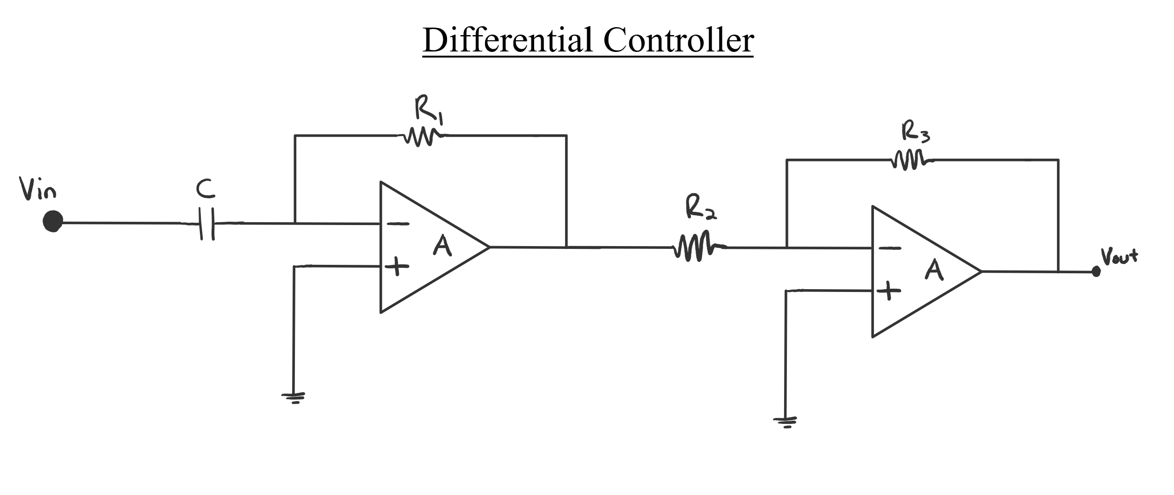
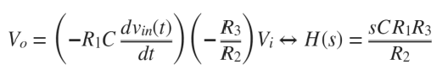
Feedback Amplifiers: Differential Controller
Again, using two op-amps, two resistors, and two capacitors, we can form a differential controller by swopping the locations of the capacitor and first resistor in the Integrator design.
This controller is used to provide anticipation action, as it can provide a gain to the rapid change of the control erroraAZZZZZZSQ

Slide 11
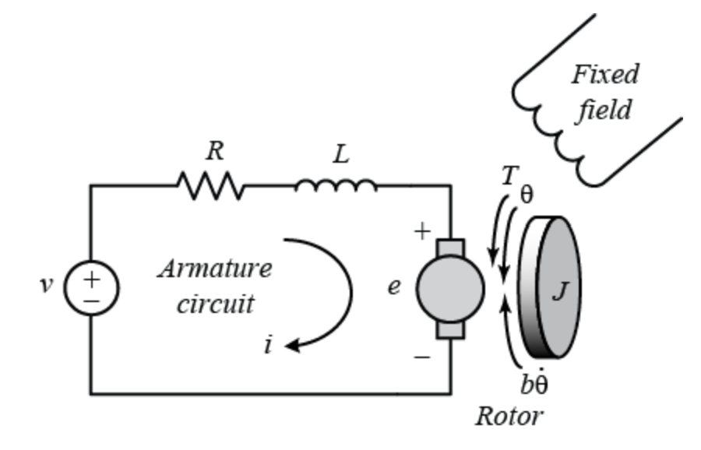
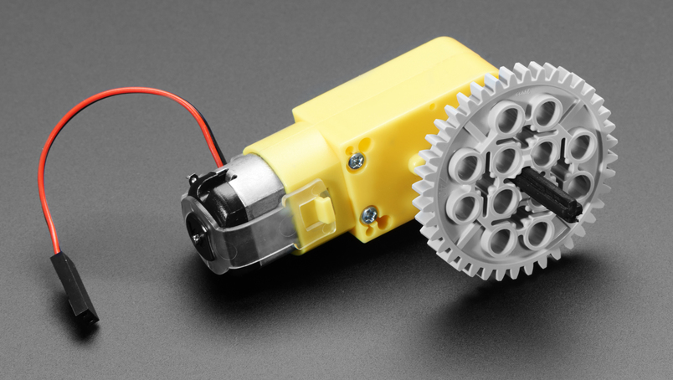
DC Motor Speed Control
Physical Parameters and Governing Equations for Electric Motors
Electric Motor converts between mechanical energy and electrical energy
Inductor with a magnet that produces a current from an applied voltage across its terminals. This current then gives way to torque on the shaft of the motor which can be used to power rotation loads like wheels, propellers, etc...
Energy can be converted from mechanical into electrical, where external torque produces a current
Then applying some voltage can produce a desired torque
Thus, an electrical motor's angular velocity can be controlled through the design of electrical circuits that apply this desired voltage, which confirms we can design Operational Amplifier circuits that are analogous to PID control.
Electric equivalent circuit of armature
Lego Motor

Slide 12
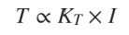
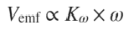
Derive Governing Eqs for Motor
Lego Motor
Used for some electronics circuits/projects
Operational voltage 9V DC
Low friction and used for high-speed design
Motor Constant derived from MIT Robotics Seminar
Torque of Lego Motor
I = (9V/25Ω)
Kt = 0.25 Nm/A
T = (Kt)(I) = (9/25)(0.25) = 0.089Nm
EMF of Lego Motor
Vemf = (Kω)(ω)
9V = (Kω)(35.6rad/s)
Kω = 0.2528, which is approximately 0.25
Lego Motor
For all brushed motors Kt = Kw

Slide 13
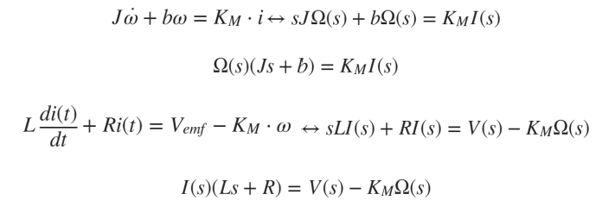
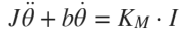
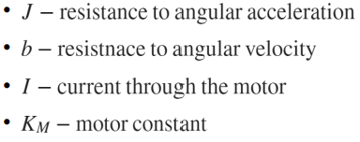
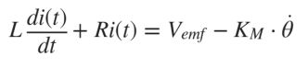
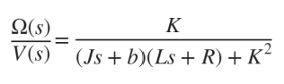
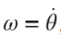
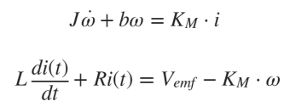
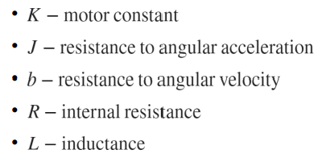
Derive Governing Eqs for Motor
Applying Newton’s 2nd Law and KVL:
The Current and Torque equation is:
where,
The EMF Voltage and Angular Velocity equations are:
then substituting , we get the two equations:
Laplace Transform of Equations:
We can substitute in equivalence of I(s) to get:
where,

Slide 14
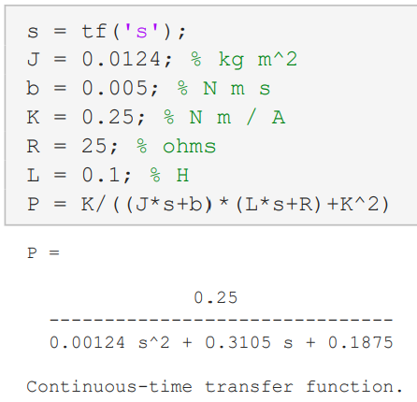
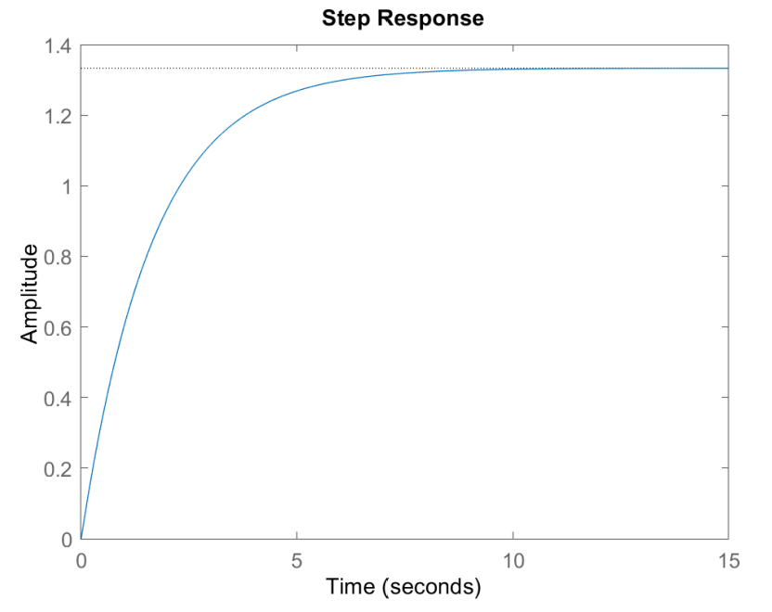
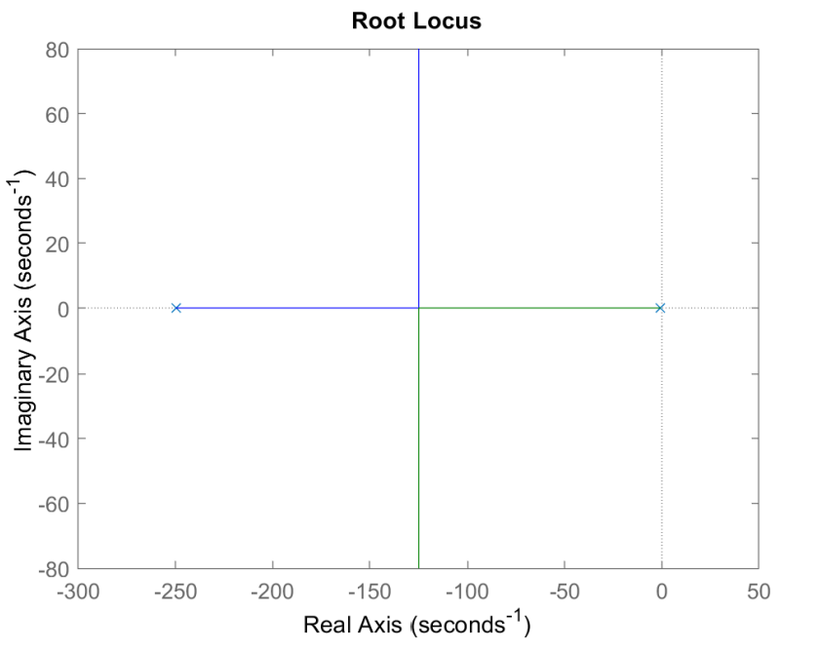
MATLAB Analysis of Plant: P(s)
System Function contains poles at -250 and -0.61
So, the system is open-loop stable but want to increase the step response to implement PID parameters to reach the desired velocity in a faster response
Plan to show how different PID parameters affect performance of velocity

Slide 15
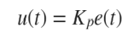
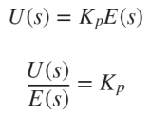
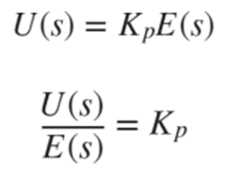
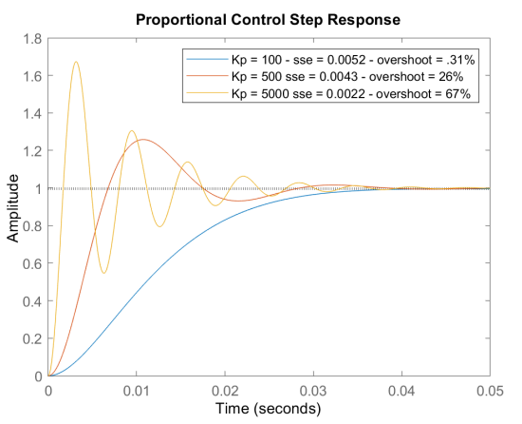
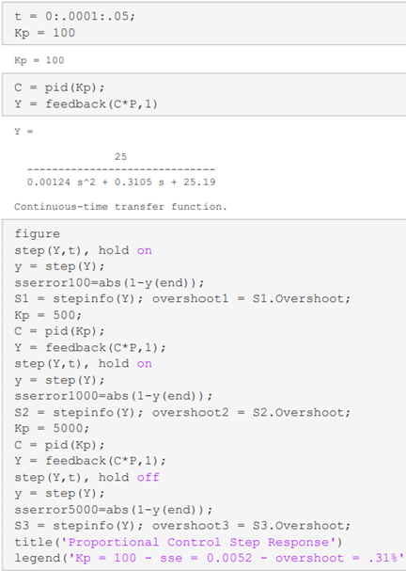
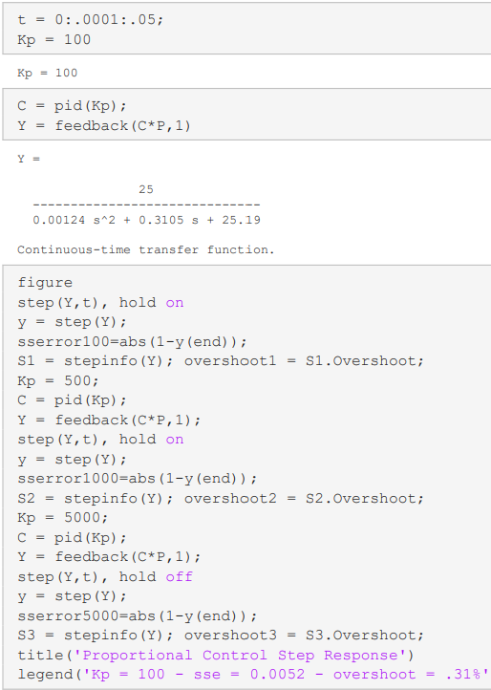
Effects of Proportional Control on Motor
Proportional Control provides amplification to the error term by some proportional constant - Kp, which results in faster response by the system
System approaches steady-state quicker with proportional control, but there is a trade-off that introduces overshoot % the faster the rise-time.
Introduces an underdamped system the higher the proportional gain becomes

Slide 16
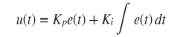
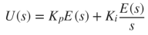
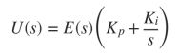
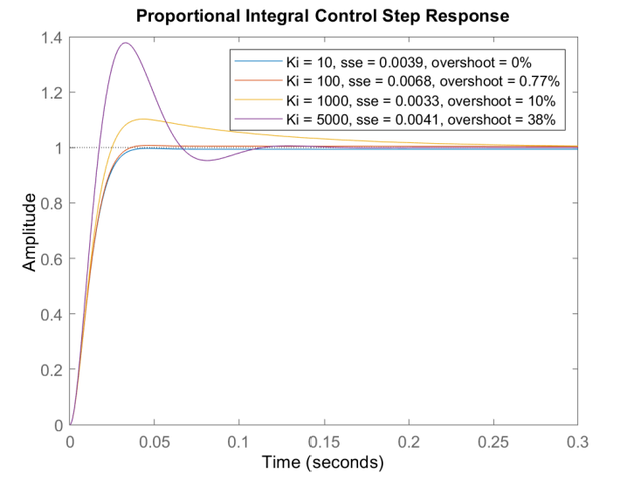
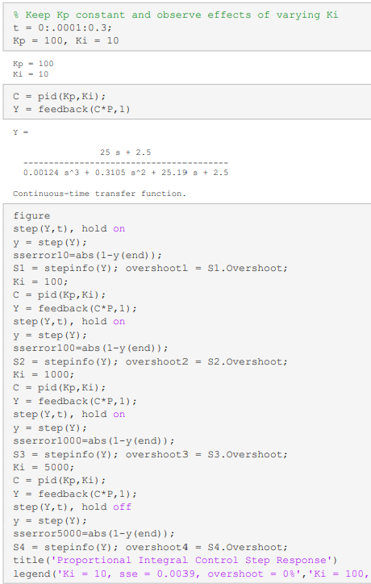
Effects of PI Control on Motor
Increasing value Ki results in a decrease in steady-state error, but there is an increase in overshoot %, which solidifies that there is an inverse relationship between these system specifications.
This phenomenon occurs because if a steady-state error exists, the integration will continue to grow larger and larger over time, which takes the control signal longer to increase enough to eliminate the error

Slide 17
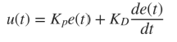
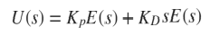




Effects of PD on Motor
PD control doesn't decrease the steady-state error and the higher the Kd term the larger the steady-state error becomes.
Once the error term stops changing, then the derivative of the error is no longer significant to affect the control signal.
The PD control can cause overdamping to the system, though the system has a faster rise time and settling time,i.e., reaches steady-state more rapidly.

Slide 18




Effects of PID on Motor
After experimenting:
Kp = 6000
Ki = 3600
Kd = 100
This design includes all of the benefits from the previously described controllers:
Fast reaction of proportional controller
Reduction in steady-state error from the PI controller
Dampening effect of the PD controller
System approaches steady-state in about 25 msecs, has steady-state error of 0.009 and 0% overshoot

Slide 19




Op-Amp PID Controller Realization
Here, in order to realize the necessary values for the PID constants, appropriate values for the resistors and capacitors need to be chosen such that the Op-Amp circuits are analogous to the generated MATLAB transfer functions.
The values for the PID constants were:

Slide 20

Analog PID Controller using Op-Amps

Slide 21
References
[1] Åström Karl J., & Murray, R. M. (2021). Feedback systems: An introduction for scientists and Engineers. Princeton University Press.
[2] Alexander, C. K., & O., S. M. N. (2021). Fundamentals of Electric Circuits. McGraw-Hill.
[3] Introduction: PID Controller Design. Control Tutorials for MATLAB and Simulink - Introduction: PID Controller Design. (n.d.). Retrieved April 25, 2022, from https://ctms.engin.umich.edu/CTMS/index.php? example=Introduction§ion=ControlPID
[4] “Emf Equation of a DC Generator.” Circuit Globe, November 16, 2015. https://circuitglobe.com/emf-equationof-dc-generator.html
[5] MIT . (n.d.). Random Hall Lego Robotics Seminar. Retrieved from http://web.mit.edu/sp.742/www/motor.html
[6] Feedback Amplifier Design. Feedback Amplifier Design - MATLAB & Simulink Example. (n.d.). Retrieved April 25, 2022, from https://www.mathworks.com/help/control/ug/feedback-amplifier-design.html

